Slide 1

Endpoint of a Ballistic Dyakonov-Shur Instability
Jack H. Farrell
APS Global Physics Summit
2025-03-19

Slide 2
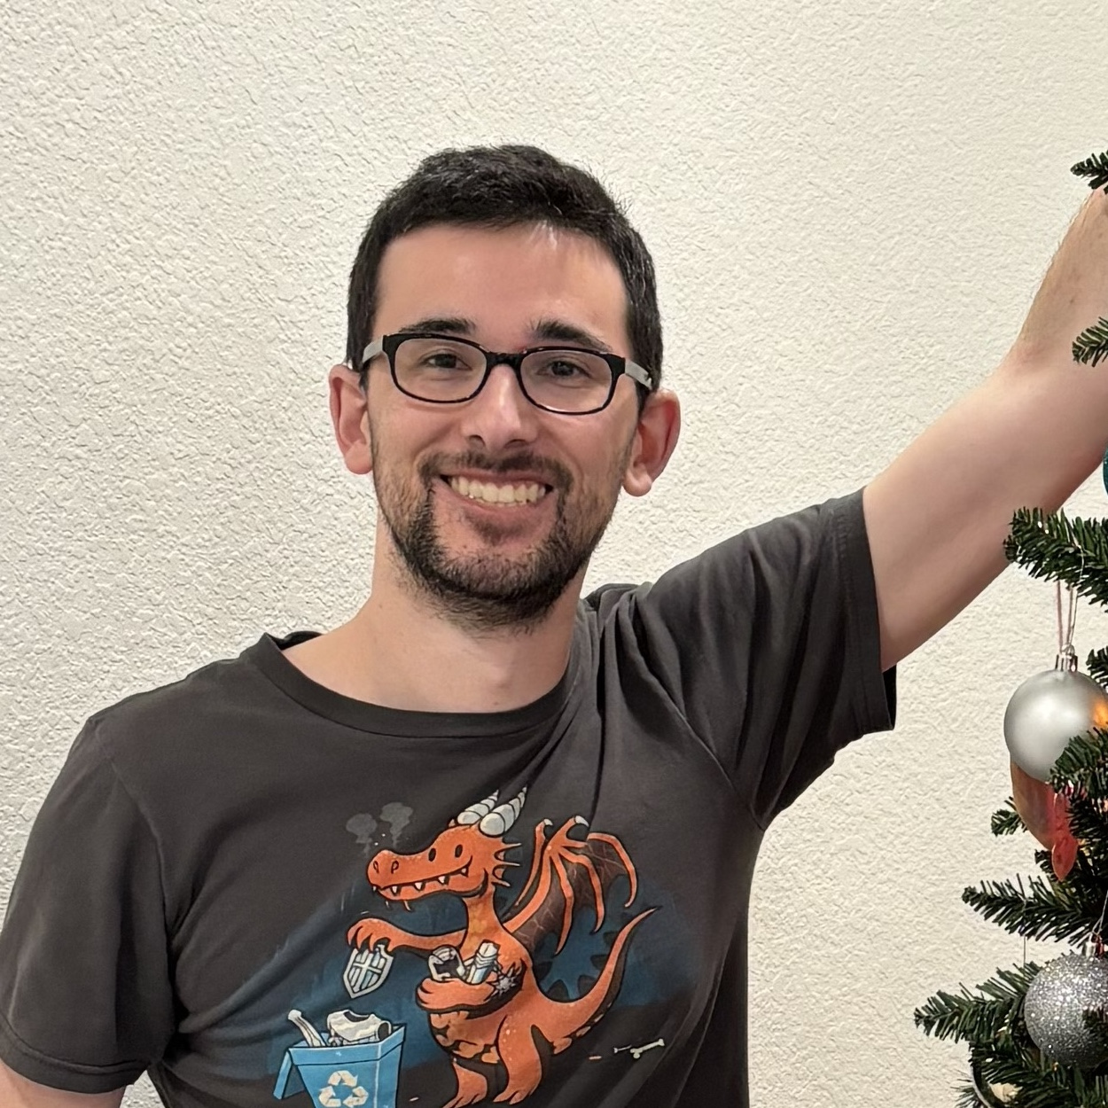
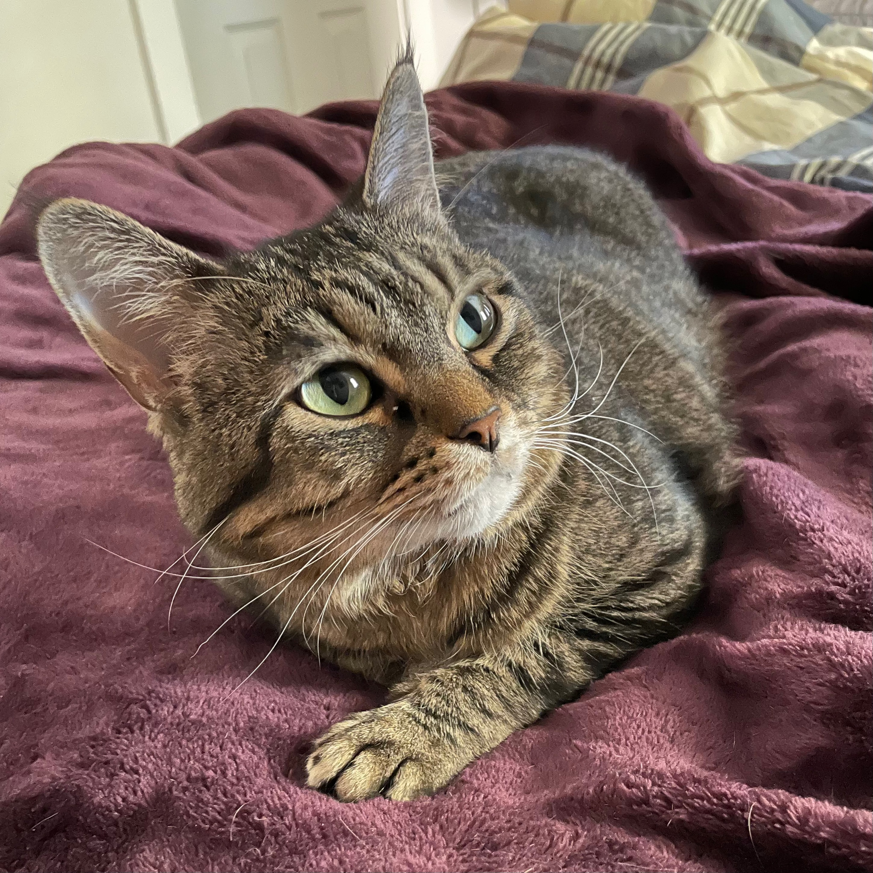
Acknowledgments
Andy Lucas
(Advisor)
Rogue
(Cat)

Slide 3


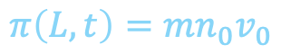

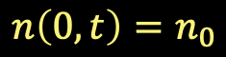
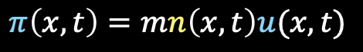
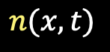
Dyakonov-Shur Instability
$$L$$
$$e^{−}$$
$$n(x,t)$$
$$n\left(0,t\right)=n_{0}$$
$$π\left(x,t\right)=mn\left(x,t\right)u(x,t)$$
$$π\left(L,t\right)={mn}_{0}v_{0}$$
[Dyakonov, Shur, 1993] :
normal modes $δn, δv∼e^{ikx−iωt}$
$Re\left(ω\right)=\frac{πs}{2L}$ —Terahertz!
$Im\left(ω\right)=\frac{s^{2}−v_{0}^{2}}{2Ls}\log\left|\frac{s+v_{0}}{s−v_{0}}\right|>0 if v_{0}<s$

Slide 4

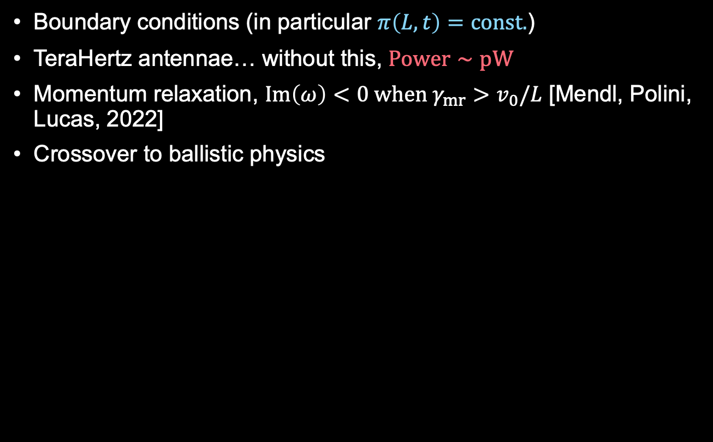
Obstacles
Boundary conditions (in particular $π\left(L,t\right)=const.$)
TeraHertz antennae… without this, $Power∼pW$
Momentum relaxation, $Im\left(ω\right)<0 when γ_{mr}>v_{0}/L$ [Mendl, Polini, Lucas, 2022]
Crossover to ballistic physics
Today’s punchline: ballistic transport should favour the DS instability; in particular, $Power∼τ_{ee}^{2}$ near instability onset

Slide 5



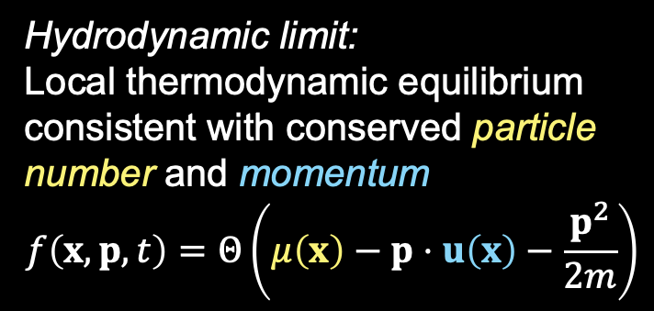
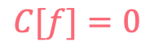
A nonlinear cartoon
Take gas of fermions with $ε\left(p\right)=p^{2}/2m$
They have a distribution function $f(x, p, t)$, which in equilibrium and near $T=0$ is$f_{0}=Θ\left(ε_{F}−p^{2}/2m\right)$
$$∂_{t}f+\frac{p}{m}⋅∇f=C[f]$$
Hydrodynamic limit:
Local thermodynamic equilibrium consistent with conserved particle number and momentum
$$f\left(x,p,t\right)=Θ\left(μ\left(x\right)−p⋅u\left(x\right)−\frac{p^{2}}{2m}\right)$$
Ballistic limit:
$$C[f]=0$$
$$C\left[f\right]≈\frac{1}{τ_{ee}(p)}\left\{Θ\left(μ\left(x\right)−p⋅u\left(x\right)−\frac{p^{2}}{2m}\right)−f\right\}$$

Slide 6
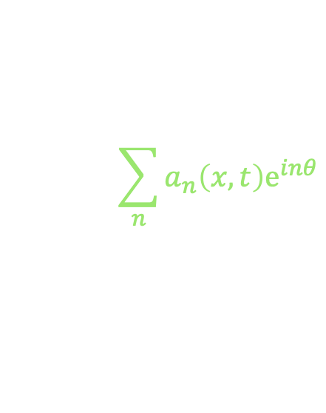



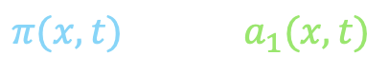
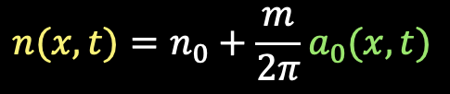
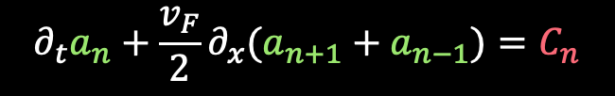
A nonlinear cartoon
Parameterize:
Giving
Final ingredient: presence of background flow $u_{0}$
$$\sum_{n}{a_{n}\left(x,t\right)e^{inθ}}$$
$$n(x,t)=n_{0}+\frac{m}{2π}a_{0}(x,t)$$
$f−f_{0}≡ δ\left(ε_{F}−ε\right) ×$
$π(x,t)=\frac{mv_{F}}{2π}a_{1}(x, t)$
$$∂_{t}a_{n}+\frac{v_{F}}{2}∂_{x}(a_{n+1}+a_{n−1})=C_{n}$$
$$∂_{t}→∂_{t}+u_{0}∂_{x}$$

Slide 7
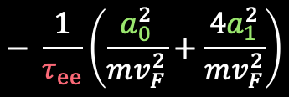
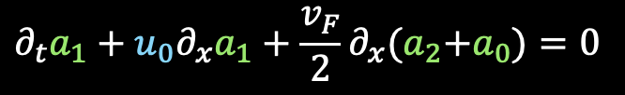
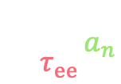
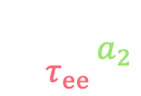



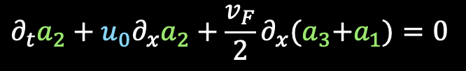
A nonlinear cartoon
$$∂_{t}a_{0}+u_{0}∂_{x}a_{0}+v_{F}∂_{x}a_{1}=0$$
$$∂_{t}a_{1}+u_{0}∂_{x}a_{1}+\frac{v_{F}}{2}∂_{x}{(a}_{2}+a_{0})=0$$
$$∂_{t}a_{2}+u_{0}∂_{x}a_{2}+\frac{v_{F}}{2}∂_{x}{(a}_{3}+a_{1})=0$$
$$− \frac{1}{τ_{ee}}a_{2}$$
$$− \frac{1}{τ_{ee}}\left(\frac{a_{0}^{2}}{mv_{F}^{2}}+\frac{{4a}_{1}^{2}}{mv_{F}^{2}}\right)$$
$$∂_{t}a_{n}+u_{0}∂_{x}a_{n}+\frac{v_{F}}{2}∂_{x}{(a}_{n+1}+a_{n−1})=0$$
$$− \frac{1}{τ_{ee}}a_{n}$$
at lowest order in $τ_{ee}$, right hand side vanishes, and one can show:
$$∂_{t}n+\frac{1}{m}∂_{x}π=0$$
Hydrodynamics in the “Boussinesq” approximation
$$∂_{t}π+∂_{x}\left(\frac{π^{2}}{mn_{0}}\right)+∂_{x}\left(\left(2πℏ^{2}\right)\frac{n^{2}}{4π}\right)=0$$

Slide 8
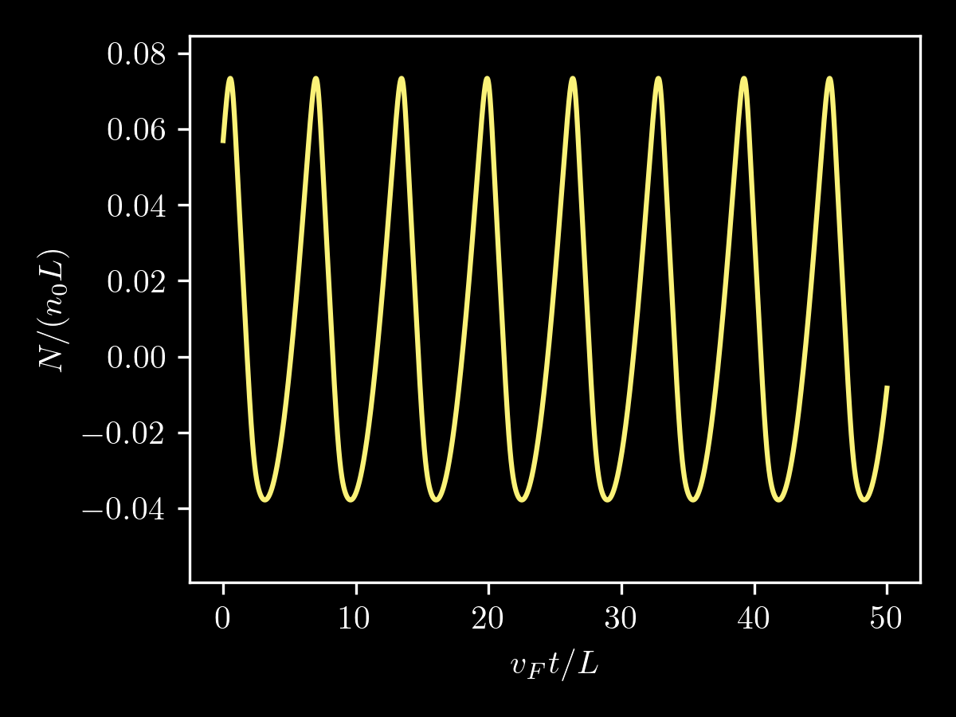
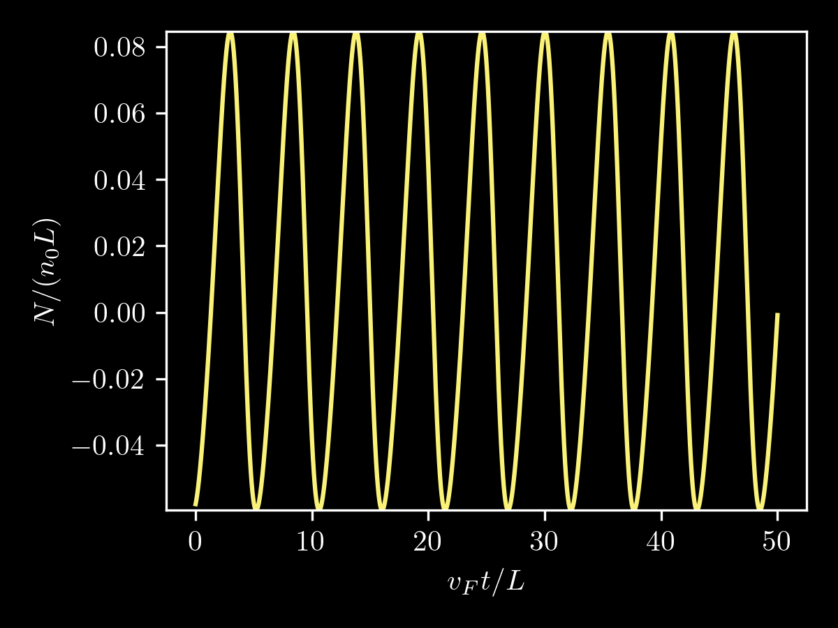



Numerics
Truncate at $n_{max}=40$
$$\frac{τ_{ee}v_{F}}{L}=0.25$$
$$\frac{τ_{ee}v_{F}}{L}=1.25$$

Slide 9
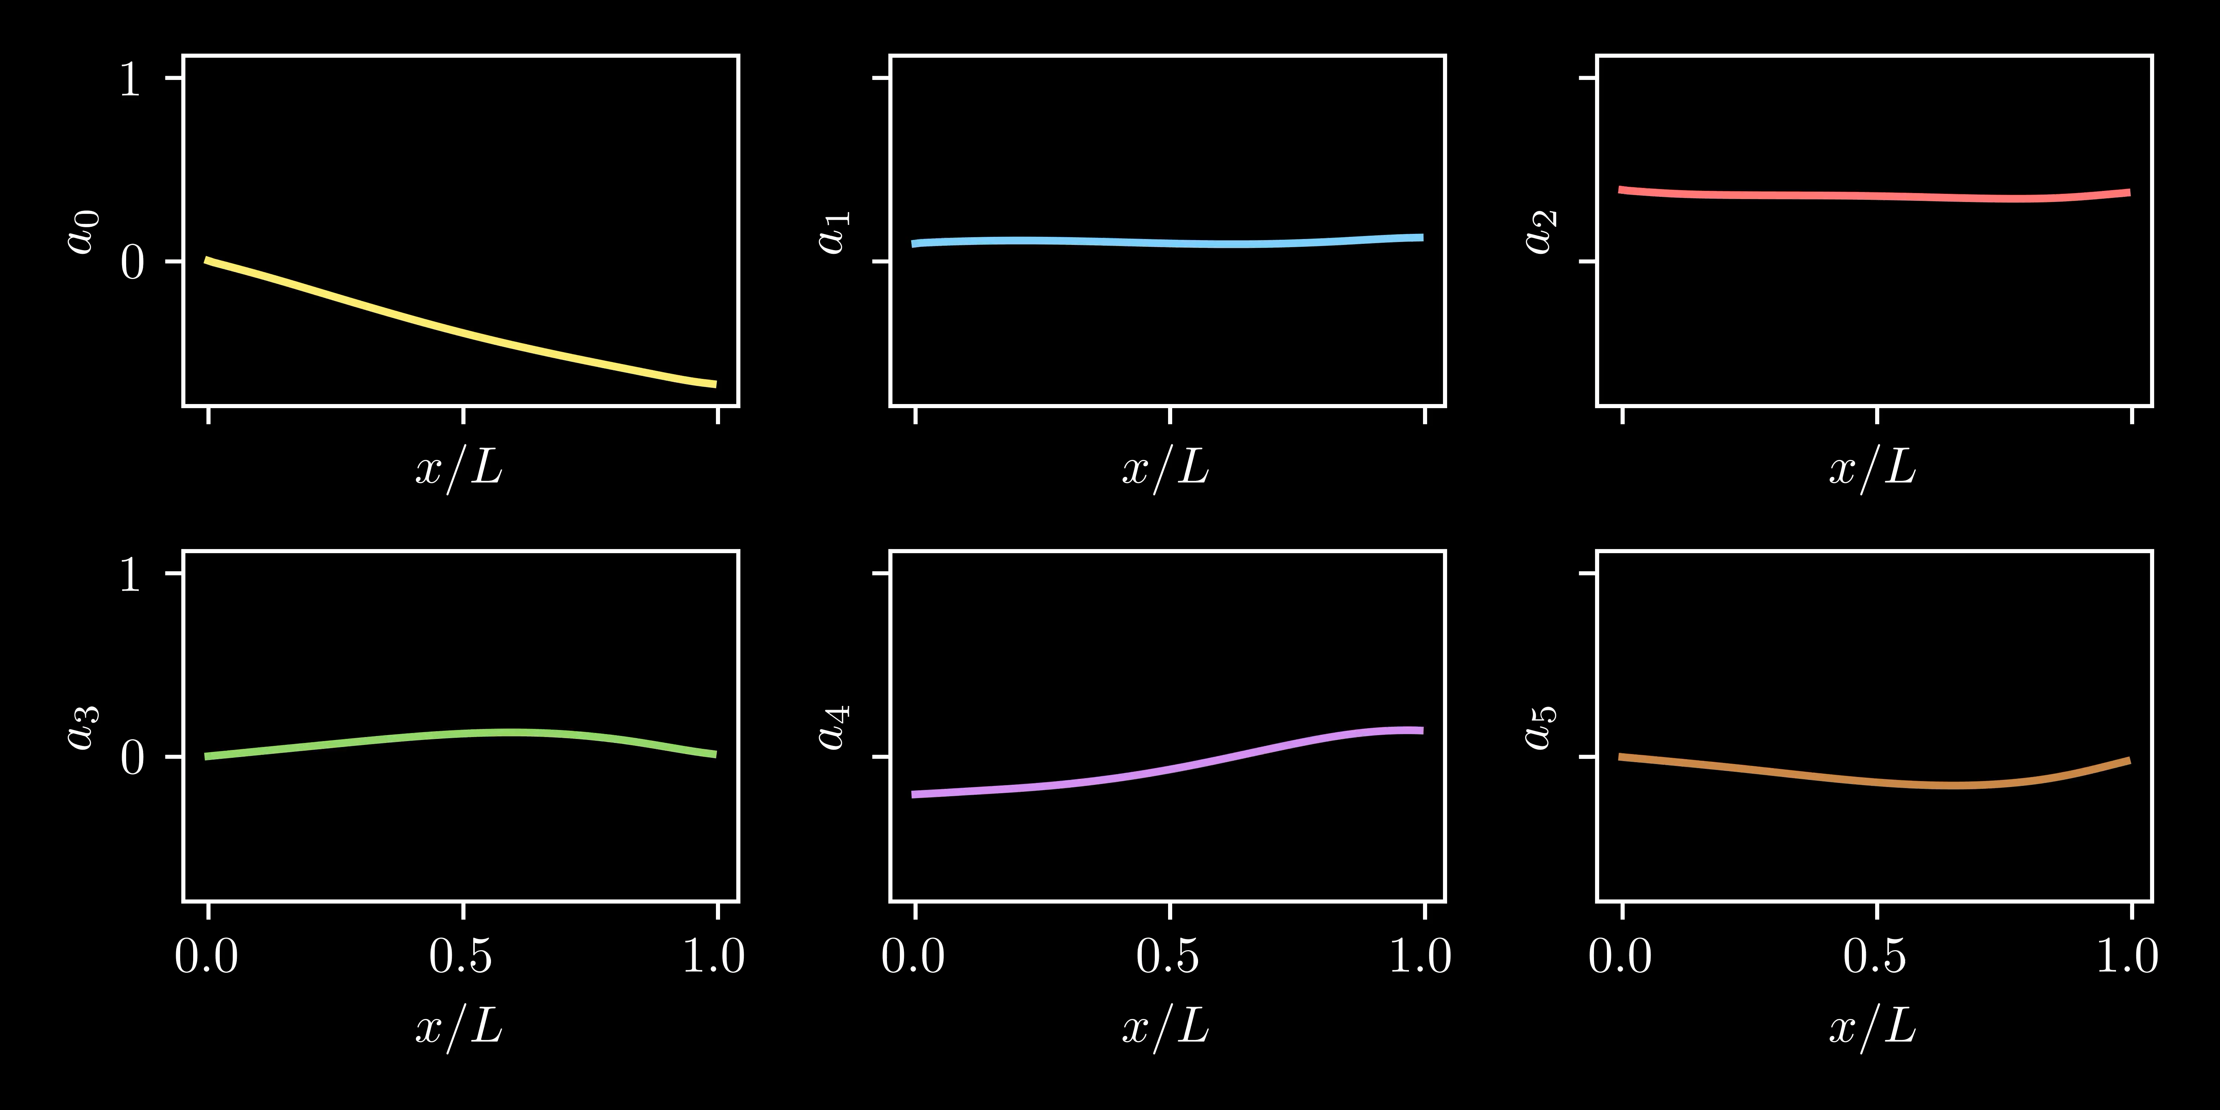

Numerics
$$\frac{τ_{ee}v_{F}}{L}=1.25$$

Slide 10
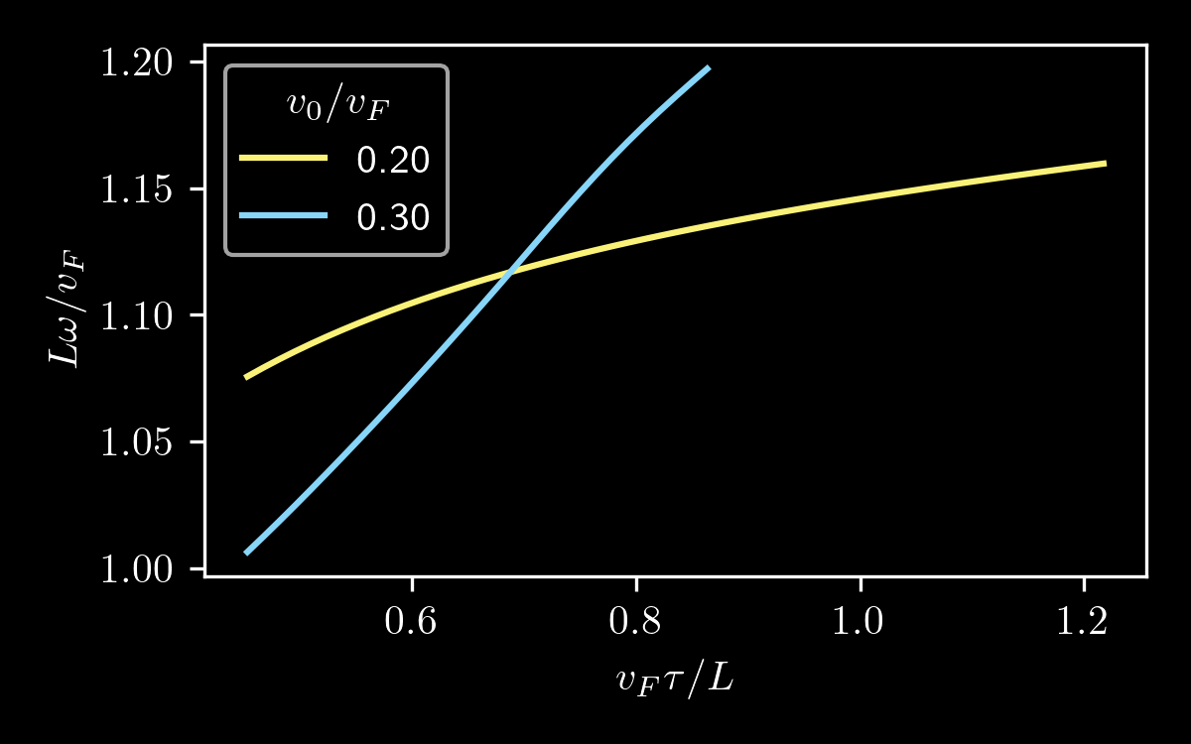
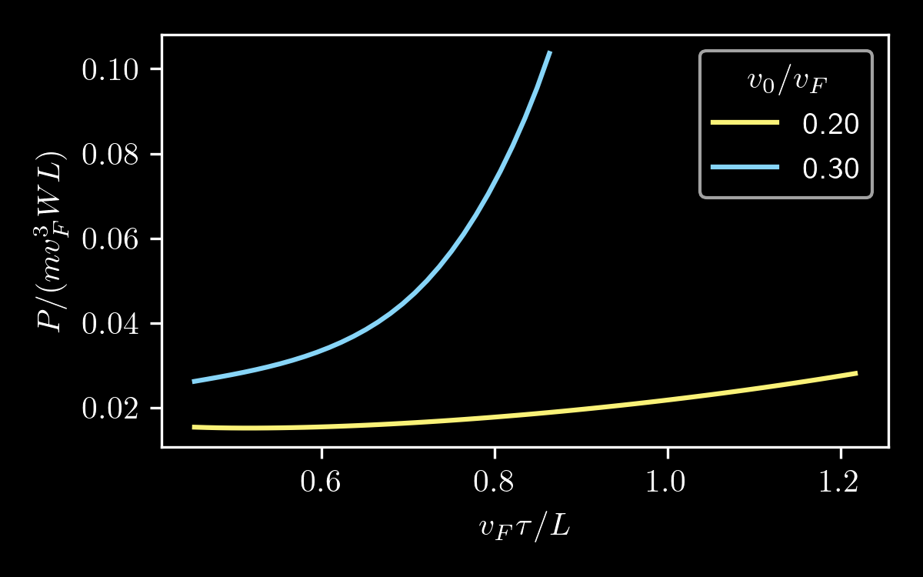

Characterization
Imagine the device is separated from a metallic gate by an oxide, forming a capacitor
Power from charge-discharge cycles:
$$Power≈\frac{1}{T}\left|\int_{0}^{T}{\frac{dt}{T}}\frac{{\left(eN\right)}^{2}}{2C}\cos{(2πt/T)} \right|$$

Slide 11

Conclusions & Outlook
ballistic transport should favour the DS instability
Illustrated in the context of a quadratic toy model for the ballistic-hydrodynamic crossover
More ideas:
Nonlinear treatment with temperature gradients in and around hydro regime
Nonlinear transport through 2D geometries
Thanks for listening! ☺
jfarrellhfx@bsky.social

